Slide 1
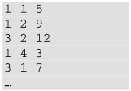
tavok.txt
utak[]
[[1,1,5],
[1,2,9],
[3,2,12],
[1,4,3],
[3,1,7],
…]
nap
fuvar
km

